Slide 1
Information Security
Introduction

Slide 2
Welcome!
Welcome to the Information Security Module! ☺
Who am I?
Mohamed Gorada
Background in Computer Science/Cyber Security research
ae0904@coventry.ac.uk

Slide 3
Course Objectives
Understand fundamentals of Information Security, including:
Describe the fundamental concepts associated with the digital security.
Risk Assessment.
the role of encryption in information security
the concept of access control in information security.
Perform penetration tests to expose the vulnerabilities of a system.
Notes:
including risks, threats, attacks and security requirements, and in relation to the confidentiality-integrity-availability (CIA) triangle.
Identify potential threats, vulnerabilities, and impacts to the organisation's information assets. Explain how risk assessment assists in determining the appropriate security measures to mitigate these risks.

Slide 4
Weekly Schedule
Every week you will have…
Pre-Activity
3 x Applied Content
Tutorial
Lab/Academic Skills Sessions
Post-Activity

Slide 5
Assignment 1 – Portfolio Assignment 2 – Individual Presentation & 1000 report
Assignments
28/03/2025 6pm
17/04/2025 6pm

Slide 6
Learning Outcomes
Describe the fundamental concepts associated with the digital security landscape including risks, threats, attacks, adversaries and security requirements, and in relation to the confidentiality-integrity-availability (CIA) triangle.
Discuss the different technologies that constitute the security mechanisms at various levels in a digitally networked environment.
Perform penetration tests to expose the vulnerabilities of a system.
Present technical solutions to a non-technical audience in an industry standard format.
Design and develop different strategies for computer and network security management and evaluate their legal, social and ethical implications.

Slide 7
Assignment 1
Task 1:
In this assignment, you are required to write a report. The purpose of this assignment is to deepen your understanding of information security principles and practices. In this assignment, you will explore various aspects of information security, including risk assessment, security policies, encryption, access control, incident response and penetration testing to expose vulnerabilities.

Slide 8
Assignment Component
Task 1:
Task-1: Information Security Risk Assessment Report – 40% Introduction: Describe the importance of information security and risk assessment and introduce the best practices and industry standards for information security risk assessment. (5%) Risk Identification: Identify the different assets and the vulnerabilities associated with them and prepare an asset register. (15%) Risk Analysis and Evaluation: Present an analysis of the identified risks of selected assets and evaluate them using the chosen industry standard approaches and provide relevant information available in the public domain to support your evaluation. (20%) Task-2: Perform Penetration Testing and Report – 40% Penetration Testing: Provide the evidence of your penetration testing to expose selected vulnerabilities in the risk assessment process. (20%) Risk Identification: Produce a penetration test report using an industry standard. (20%) Task-3: Security Policies – 20% Provide security policies for the organisation. (20%)

Slide 9
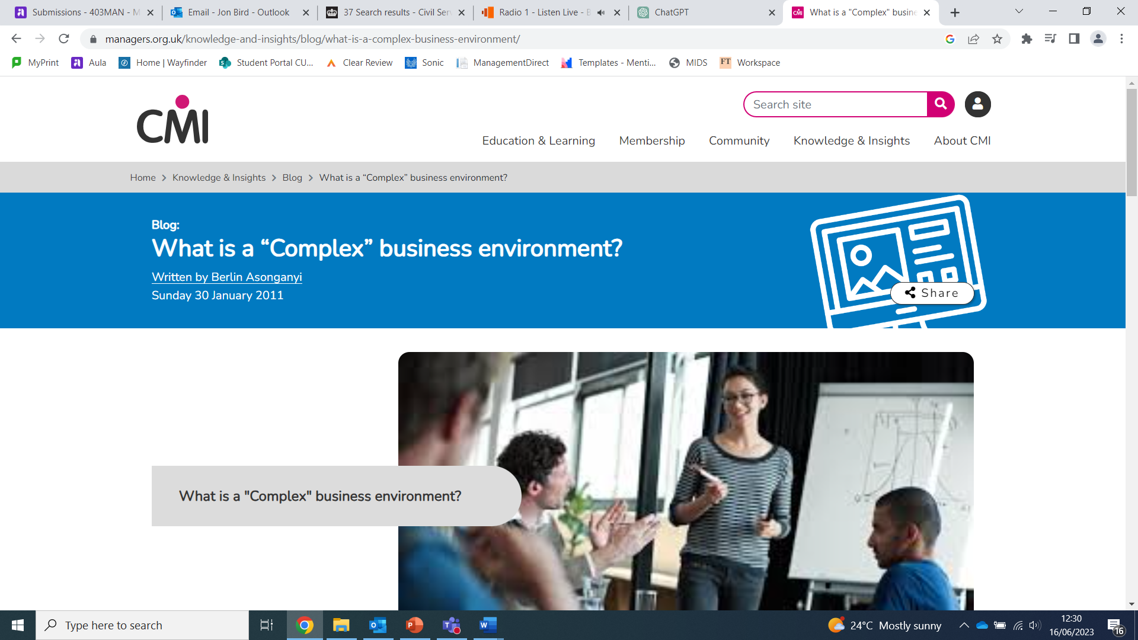
Assignment Structure
CU Group Cover Page
Introduction:
Risk Assessment.
Security Policies.
Conclusion.
penetration testing
Screenshots what you did in lab
References
Appendix
CMI Website & Online Articles

Slide 10
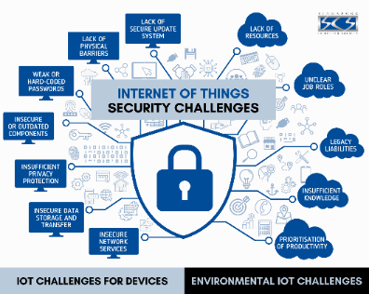


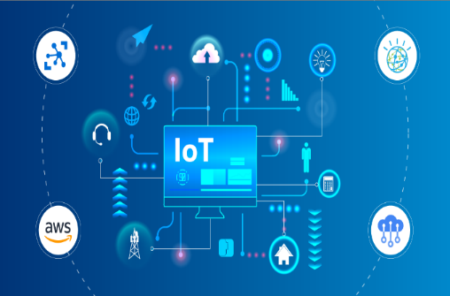
Assignment ‘Top Tips’!
Select Information Security topic you would enjoy to research and write about.
Be creative in the layout of your ‘online article’.
Make sure you use a writing structure and ensure your report aligns to LO1 , LO2 and LO3

Slide 11
Assignment 1 – Portfolio Assignment 2 – Individual Presentation & 1000 report
Assignments
28/03/2025 6pm
17/04/2025 6pm

Slide 12
Learning Outcomes
Describe the fundamental concepts associated with the digital security landscape including risks, threats, attacks, adversaries and security requirements, and in relation to the confidentiality-integrity-availability (CIA) triangle.
Discuss the different technologies that constitute the security mechanisms at various levels in a digitally networked environment.
Perform penetration tests to expose the vulnerabilities of a system.
Present technical solutions to a non-technical audience in an industry standard format.
Design and develop different strategies for computer and network security management and evaluate their legal, social and ethical implications.

Slide 13
Assignment 2
Task:
This assignment builds upon the previous assignment's risk assessment and expands on the implementation of necessary remediation measures to address the identified risks. This assignment requires preparing a 15-minute oral presentation and a 1000-word briefing report for the Board of Directors at New England Hospital, outlining identified security vulnerabilities and proposing detailed mitigation strategies.

Slide 14
Assignment Component
Task 1:
Individual Presentation: 60% Prepare an individual presentation for the Information Security Officer to communicate the findings from the risk assessment conducted in Assignment 1. The presentation should include the following elements: Executive Summary Identified Security Issues Mitigation Strategies
Task 1:
Briefing Report : 40% Produce a detailed briefing report that complements your individual presentation. The report should include the following elements: Introduction Methodology Risk Assessment Findings Mitigation Strategies Conclusion

Slide 15
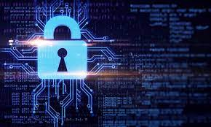
Assignment ‘Top Tips’!
Select Select Information Security topic you would enjoy to research and write about.
Be creative in the layout of your ‘online article’.
Make sure you use a writing structure and ensure your report aligns to LO1 , LO2, LO3, LO4 and LO5

Slide 16
Let’s get started!

Slide 17
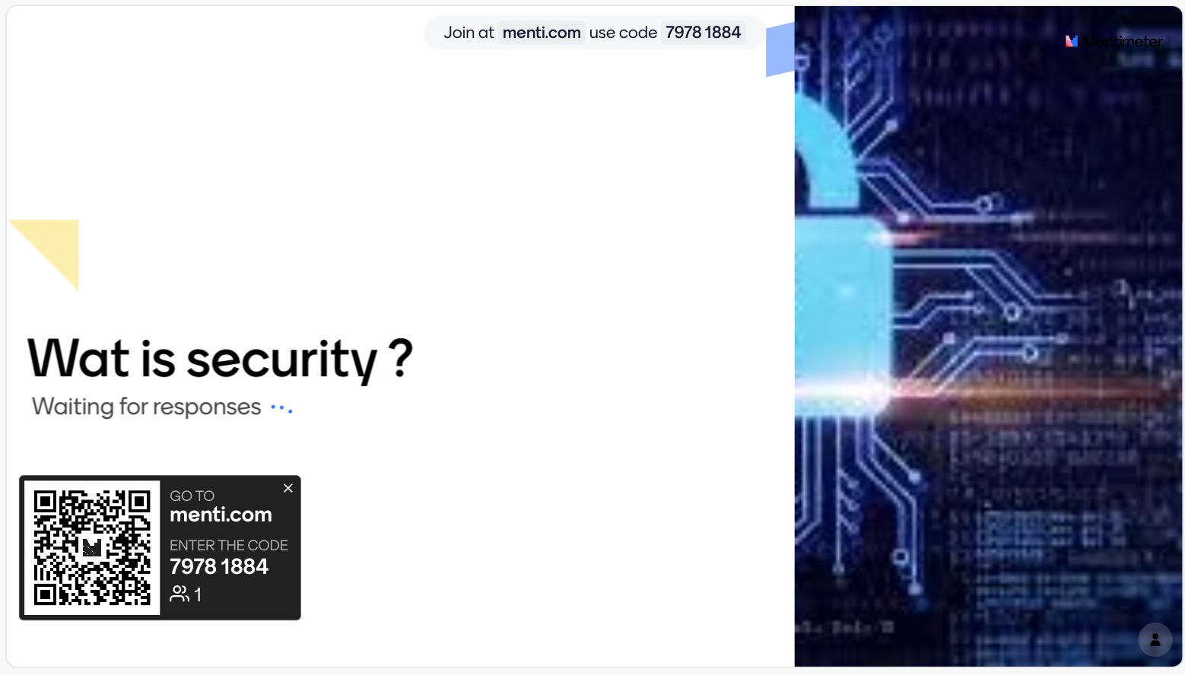
Wat is security ?

Slide 18
Definitions
Security refers to the practice of protecting something valuable from potential threats, harm, or unauthorized access.
Security is the protection of assets from harm.
It is a broad and multifaceted concept that can be applied to various domains
The primary goal of security is to ensure the confidentiality, integrity, and availability of assets or resources.
Notes:
assets are things that you own and have value. These can include things like money in your bank account, your house, your car, or even investments like stocks

Slide 19






Security domains
Here are some common domains where security is important
Physical security.
Societal security.
National security.
Safety
Environmental security
Information security
Notes:
Physical security: Physical security focuses on protecting physical assets, locations, and people from unauthorized access, burglary, theft, vandalism, and other physical threats.
Societal security safeguarding critical infrastructure systems such as transportation, energy, telecommunications, and healthcare.
National security: involves protecting a country's sovereignty, citizens, and interests from external and internal threats. This includes defense strategies, intelligence gathering, border security, and policies
Safety:Safety is about ensuring the well-being and physical security of individuals. It includes measures to prevent accidents, injuries, and harm to people, whether at home, in workplaces, or in public spaces.
Environmental security : stop pollution and Environment issue s)
Information security: ( data protection)
Information security, also known as cybersecurity, focuses on safeguarding digital data and information systems from unauthorized access, data breaches, cyberattacks, and other digital threats.

Slide 20
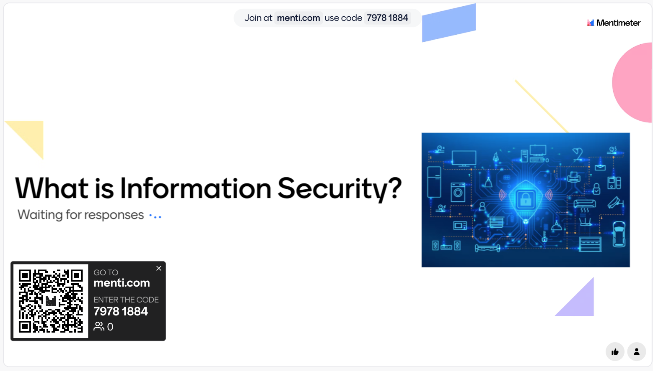
What is Information Security?

Slide 21

What is Information Security?

Slide 22
What is Information Security?
Information security, also known as cybersecurity or IT security, refers to the practice of protecting information and information systems from unauthorized access.
The goal of information security is to maintain the confidentiality, integrity, and availability of information, and to prevent the impact of security incidents.
C.I.A. triangle was standard based on confidentiality, integrity, and availability

Slide 23
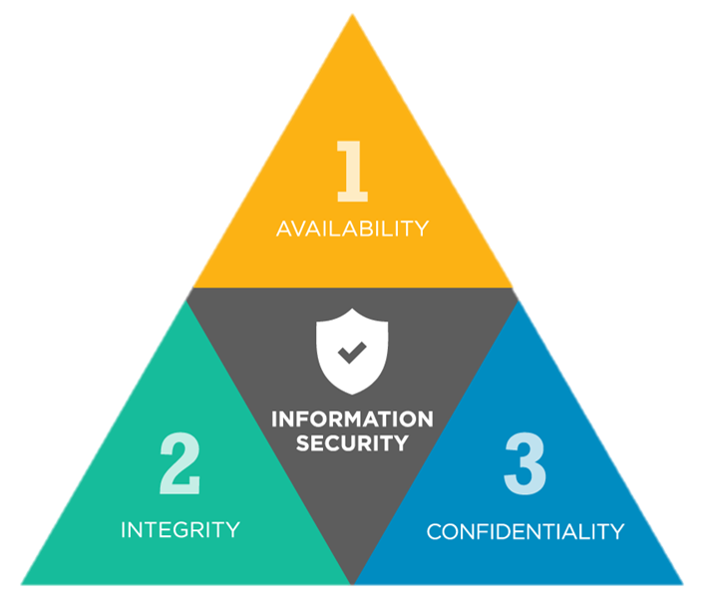
C.I.A. Triangle
The C.I.A. triangle is often used as a guide to help organizations design and implement effective information security measures that protect against a wide range of threats.

Slide 24
C.I.A. Triangle
Confidentiality: This refers to ensure that sensitive information only accessible to authorized user .
Integrity: This refers to ensure that information is accurate and complete, and that it has not been modified with in an unauthorized manner.
Availability: This refers to ensure that information is available when we are needed it .

Slide 25
Why is Information Security important?
Protection of Sensitive Data: Keeps important and private information safe from being seen or stolen by unauthorized people.
Build trust: Information security helps build trust with customers, partners, and stakeholders by demonstrating a commitment to protecting their data.
Reduce risk: Information security reduces the risk of financial losses and damage to an organization's reputation caused by data breaches or cyberattacks.
Information security: helps defend against a wide range of cyberattacks, including malware, ransomware, phishing, and denial-of-service (DoS) attacks.

Slide 26
Types of information
There are various types of information:
Personal Information: Includes data like names, addresses, Social Security numbers, and other identifiers that can be used to uniquely identify individuals.
Financial Information: Bank account numbers, credit card details, and financial transaction history.
Health Information: Medical records, diagnoses, treatment histories, and other health-related data.

Slide 27
Types of information
Business and Organizational Data:
Business Plans: Strategic documents and future plans.
Employee Records: Personnel files, payroll information, and HR data.
Customer Data: Contact information, purchase history, and preferences.
Supply Chain Information: Information about suppliers, vendors, and logistics.
Government and National Security Information:
Classified Information: Military and government secrets classified into different levels.
Law Enforcement Data: Criminal investigations, surveillance, and sensitive operational information.

Slide 28
Information Security Management
ISM: refers to the systematic approach and framework that organizations use to protect their sensitive information and data from unauthorized access.
ISM focuses on:
Evaluate threats, vulnerabilities and risks.
Control security risks by reducing vulnerability to threats.
Detection and response to attacks.
Recovery from damage caused by attacks.
Investigate and collect evidence about incidents (forensics).

Slide 29
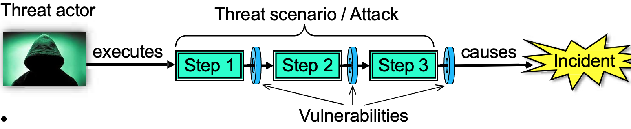
Threat, Vulnerability, Risk and Control
Threat: refers to any potential danger or harmful event that has the capability to cause damage.
Threat Actor: An active entity which can execute a threat scenario.
Threat Scenario: The set of steps executed in a (potential) cyber attack.
Vulnerability: Weaknesses or opportunities allowing a threat scenario to be executed

Slide 30
Threat, Vulnerability, Risk and Control
Security Risk
Likelihood (ease of executing a threat scenario), combined with the potential damage in case of an incident (successful attack)
Security Control
A method for removing vulnerabilities and reducing security risk

Slide 31
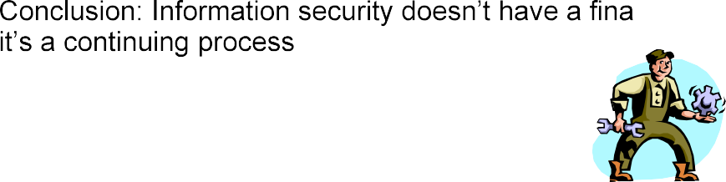
The Need for Information Security
Can we remove all vulnerabilities once and for all?
Answer:
NO we can’t
Rapid innovation and new technology creates new vulnerabilities
Information security is (still) often ignored when developing IT.
New threats that exploit vulnerabilities are invented every day.
More effective attack technique and tools are being developed.
Increased value of online digital assets makes attacks more attractive.

Slide 32
Discussion
What are the main threats to information security, and how do they impact individuals, organizations, and society?
Take 10 minutes
Discuss with team

Slide 33

Homework
Answer all questions related to the post activity and upload them to Chanel was created into a team

Slide 34
What’s next on the agenda?
Break: 20 minutes
Lab Explanation
Lab Work

Slide 35


